Slide 1
A Scheme for Factoid Question Answering Over Knowledge Base
DEIM 2019 G7- 5
Happy BUZAABA, Toshiyuki AMAGASA
2019 - 03 - 06
KDE-LAB
UNIVERSITY OF TSUKUBA

Slide 2
Outline
Introduction
Motivation
Related work
Objective
Approach
Results
Conclusion & Future work
A Scheme For Factoid Question Answering over Knowledge Base
March 6, 2019

Slide 3
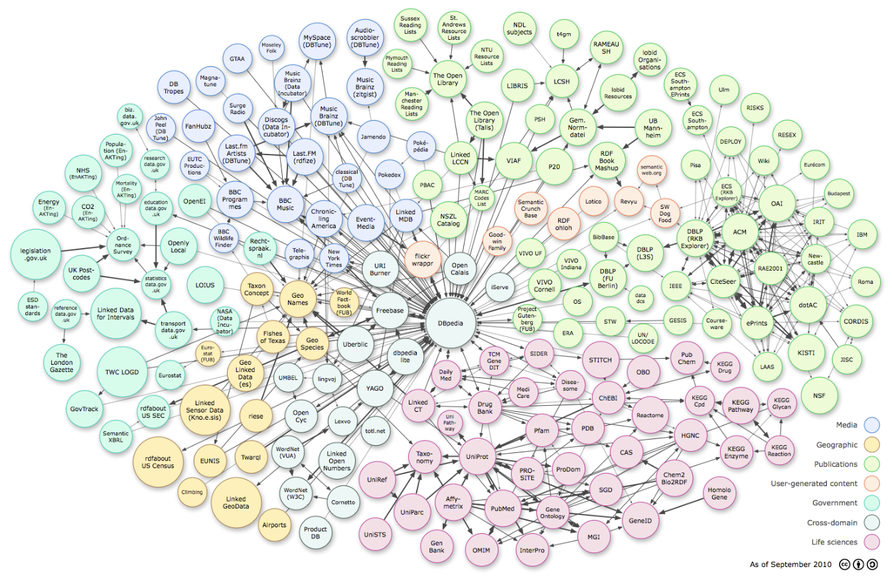
Knowledge Bases
A Scheme For Factoid Question Answering over Knowledge Base
Merch 6, 2019
Notes:
Lets start from the picture
This picture contains most of the Knowledge bases that have been widely used in both academic and industry.
Colors represent the Domains
Surface area represent the number of facts in the Knowledge base
So we have many domains and some of them are very big
But data in these KB’s is stored in a structured format

Slide 4
RDF_graph
(Subject, Relation, Object)
Ex Machina
The Tesseract
author
director
directed_by
written_by
spouse_s
Alex Garland
film
Dredd
Paloma Baeza
Child
has_spouse
Parent
Parent
Type_of_union
Nocholas Garland
Marriage
Eva Garland
Grand_Child
SPARQL query
Out put
PREFIX: <http://bedrock/>
SELECT ?subject ?predicate ?object
WHERE {?subject ?predicate ?object}
Subject Predicate Object
Alex Garland director Ex Machina
Ex Machina directed_by Alex Garland
The Tesseract author Alex Garland
Paloma Baeza has_spouse Alex Garland
A Scheme For Factoid Question Answering over Knowledge Base
March 6, 2019
Notes:
For example for RDF data, it is structured in Subject, Predicate and Object format.
So for one to access this data they need to write a SPARQL query in order to to access the information they want.
But it is hard for non technical people with a different specialty but would like to access this information.

Slide 5
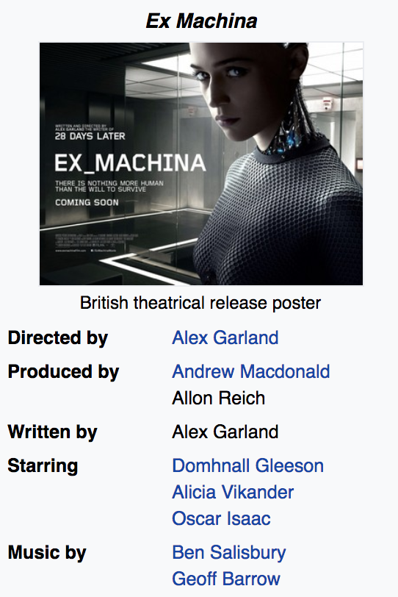

Question answering over Knowledge base
What else did the director of the movie Ex Machina direct?
Semantic Parsing
select ?y
fb:m.0fkf28
fb:object.type
fb:film.film
fb:m.0fkf28
fb:film.film.directed_by
?y
?x
fb:film.director.film
?y
?y
fb:object.type
fb:film.film
Annihilation 28 Days Later Sunshine
Never let Me Go Dredd
A Scheme For Factoid Question Answering over Knowledge Base
March 6, 2019
Notes:
So what KB question answering does is to allow user to pose questions in natural language and access answers from the Knowledge base.
For example given some information about Ex Machina, one may ask a question like what else did the director of the movie Ex Machina direct.
So the QA over KB system will try to first understand this question either by semantic parsing methods and convert this question into a structured query which is then executed on the KB to get the answers.
And the advantage of using KB for question answering is that you can get more precise and accurate answers.

Slide 6
Task definition
Question:
Where was Barack Obama born?
Formal definition:
1 – Subject: Barack Obama
1 – Relation: place_of_birth
Knowledge Base
USA
The audacity of hope
8/04/1961
bornOn
President _of
Leader
authored_by
home_to
spouse_s
Barack Obama
Hawaii
Place_of_birth
Michelle Obama
has_spouse
origin
Parent
daughter_to
Kenya
Sasha Obama
Candidate triple:
(‘Barack Obama’; ‘place_of_birth’; ‘Hawaii’)
A Scheme For Factoid Question Answering over Knowledge Base
March 6, 2019
Notes:
So in our work we try to tackle the problem of question answering over KB, but we specifically focus on simple factoid question answering.
And simple questions are questions with one subject and one relation.
Assuming we have a natural language question
Where was Barack Obama born
And a structured knowledge base with a set of triples
where by a triple has two nodes connected by an edge
The task is to come up with a candidate triple from the KB that provides an answer to the question.
We make two assumptions:
We assume that the source entity is mentioned in the question
Question can be answered by a single fact.

Slide 7
Motivation

Slide 8
Motivation
Simple questions are commonly used in web search, voice assistants, chatbots etc.
Availability of a large simple questions benchmark of 108, 442 questions.
The simple questions benchmark is far from being solved with
(76.4% state-of-the-art)
A Scheme For Factoid Question Answering over Knowledge Base
March 6, 2019
Notes:
So why are we interested in studying this problem:
Simple questions are commonly used in web search, voice assistants and chatbots
So in 2015 bodes introduced a simples questions benchmark with over 100,000 questions
And this problem is far from being solved
And here is some of the previous work

Slide 9
Related work

Slide 10
Related work
Memory networks (Bodes et al., 2015)
Generalization Module
Weighted sum
Output Module
Dotproduct + Softmax
{f₁, f₂,..,f_{|kb|}}
{c₁}
Input Module
Knowledge Base
Question
Response
A Scheme For Factoid Question Answering over Knowledge Base
March 6, 2019
Notes:
So in 2015, bodes introduced a simple questions dataset and proposed a memory network to tackle this problem
The memory network proposed consists of 3 modules, the Input Module, which pre-process the KB and question,
The Generalization module which memorises the inputs, pays attention to specific parts of KB conditioned to the question and updates the weights
And the output Module which performs memory lookups to return the fact with a response.
So bodes’s paper triggered a line of work, that encouraged other researchers to solve the SimpleQA problem.

Slide 11
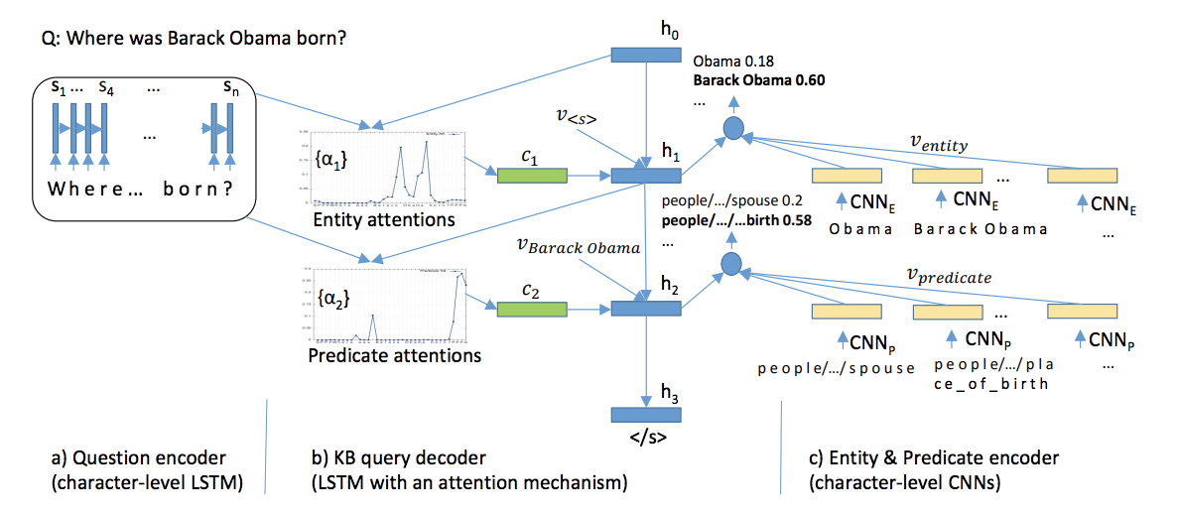
Related work
Character-level attention-based Encoder-Decoder (Golub & He, 2016)
A Scheme For Factoid Question Answering over Knowledge Base
March 6, 2019
Notes:
This other work applys character-level attention based modeling.
In this model every question is decoded to a KB query that contain the topic entity and a predicate.
So this model takes as Input a question, set of candidate entities and candidate predicates to produce a likelihood score of generating an entity and predicate given a question.

Slide 12
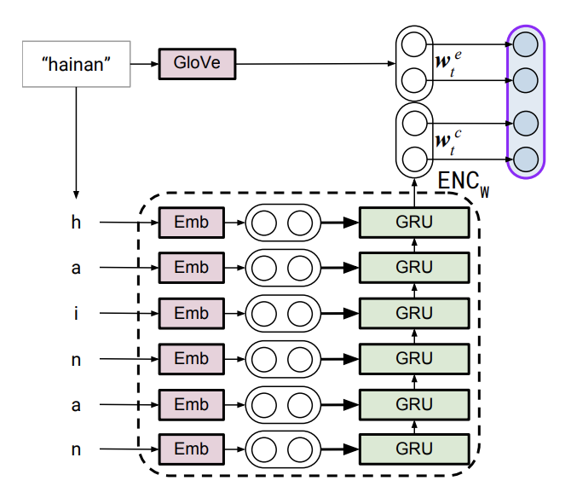
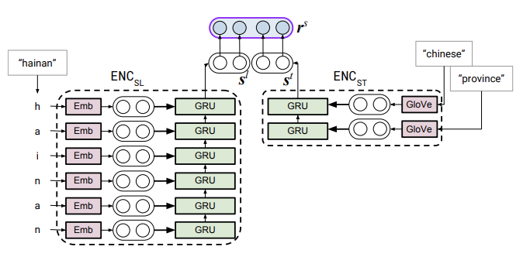
Related work
Hierarchical word/char-level Encoder ( Lukovinikov et al., 2017)
r_{q} = (r_{q}^{s}, r_{q}^{p})
_{Sp(q,p)} = cos(r_{q}^{p}, r^{p})
_{Ss(q,s)} = cos(r_{q}^{s}, r^{s})
r^{p}
/meteorology
GRU
Glove
GRU
Glove
/affected
GRU
Glove
_area
encoding_each word
GRU
Glove
/cyclone
hainan chinese province
meteorology/affected_area/cyclone
What cyclone affected Hainan?
Subject_encoding
Predicate_encoding
Question Encoding
KB_Facts Encoding
A Scheme For Factoid Question Answering over Knowledge Base
March 6, 2019
Notes:
The other work applys Hierachical word and char-level encoding.
Where by the words in the question are encoded using both word and character level to come up with the Question vector representation.
A similar encoding is done on the KB
And the entity and relation encoded separately
And finally they calculate the similarity between the
question and KB representations from which they generate candidate triples and rank them to find the top triple as the answer.
These previous works train end to end models that introduce new features that make the QA model more complex
And the question here is if these complexities are necessary for Simple QA task.

Slide 13
Objective
Examine the necessity of complex models for simple QA
Explore simple but strong baseline methods that achieve reasonable performance on the simple QA task.
Final goal is to enhance the performance of Simple QA system using baseline methods
A Scheme For Factoid Question Answering over Knowledge Base
March 6, 2019
Notes:
So with this question in mind our objective:

Slide 14
Approach

Slide 15




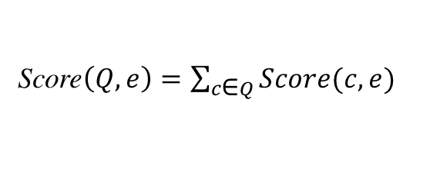
Proposed Approach
Score$\left(Q, e\right)=\sum_{c\text{∈} Q}^{ }{Score(c, e)}$
$$\underset{e^{′}}{argmax} \max_{\left(e −r − e^{′}\right)∈\text{I}\text{reach} }Score(Q,e){ }$$
Score$\left(c, e\right)=\max{\text{n}\text{∈}N(c)} BM25(n, e)$
e| r | $e^{′}$
Standard RNN
CRF
fact
Entity detection
Entity Linking
Candidate list (e, Score$\left(Q, e\right))$
Question
Entity: I Relation: r
Filtering
Relation Prediction
Structured
query
Standard RNN
Standard CNN
I _{inv}
I _{reach}
Inverted Index
Reachability Index
Knowledge Base
Build Index
Subj| rel | Obj
A Scheme For Factoid Question Answering over Knowledge Base
March 6, 2019
Notes:
Now we take a different approach of decomposing the QA problem in different components and solve each of them separate.
So given a question,
We first do entity detection and relation prediction to come up with a structured query.
Which we use to do question answering.
Our structured query is made up of the entity which is a substring of the question obtained from sequence tagging
And relation which is the output of the classifier.
So we build two indexes from the knowledge base to be able to do question answering;
Inverted index maps any n-gram to nodes in the KB with the associated scores
And so we get a list of candidates entity nodes
And use the reachability index to filter out nodes that can’t produce a reasonable answer
And finally we get answer as output.
Reachability Index maps nodes to other nodes (nodes in the freebase subset to all nodes reachable by a single relation)
The above is a quick mapping to be able to do QA in a very efficient way.

Slide 16
Explored Methods for each Component
BiLSTM
Recurrent Neural Network (RNN)
Entity Detection
BiGRU
Conditional Random Field (CRF)
BiLSTM
Recurrent Neural Network (RNN)
Relation Prediction
BiGRU
Convolutional Neural Network (CNN)
A Scheme For Factoid Question Answering over Knowledge Base
March 6, 2019
Notes:
So the methods we explore are RNN and CRF for entity detection
And for Relation prediction we use RNN and CNN

Slide 17


Approach: Entity detection - RNN
where
was
Barack
Obama
born
Embedding layer
Hidden layer
RNN (BiLSTM/BiGRU)
Fully Connected layers
0
0
I
I
0
I : Entity
0 : Non-entity
A Scheme For Factoid Question Answering over Knowledge Base
March 6, 2019
Notes:
For Entity detection:
We formulate this as a sequence tagging problem
And do prediction at every time step
The embedding layer maps each word index to a 300 embedding dimension and we use Glove pre-trained embeddings.
The hidden layer combines the current word embedding with the previous hidden state to compute the current state hidden representation.
The fully connected layers project the hidden layer representations to the output space of either entity or non entity.

Slide 18
Approach: Entity detection - CRF
Conditional Random Field: A conditional sequence model that represents the probability of a hidden state sequence given some observation
Stanford Named Entity Recognizer (NER):
Sequence labels: 4 classes
Person, Organization, Location, not-entity
We considered:
Entity : (Person, Organization, Location)
Two Classes : Entity
: Non-entity
A Scheme For Factoid Question Answering over Knowledge Base
March 6, 2019
Notes:
We also use CRF as our non-neural network method for Entity detection.
For CRF we use the Stanford NER which is a tool that can label a sequence of words into 4 classes of Person, Organization, Location and non-entity.
But in our case we consider the first three classes as entity.
So ultimately there were two classes.
This tool can extract features like current/ previous/next word, POS tags and character n-gram.

Slide 19
Approach: Relation Classification - RNN
where
was
Barack
Obama
born
Embedding layer
Hidden layer
RNN (BiLSTM/BiGRU)
Fully Connected layers
People/person/place_of_birth
A Scheme For Factoid Question Answering over Knowledge Base
March 6, 2019
Notes:
We also use BiLSTM and BiGRU
But different from entity detection because relation prediction is based on the whole sentence
So we only consider the final hidden state.
So there are 1,837 unique relation types in the KB. And the objective is to do large scales classification with all possible labels and assign a relation type to the question.

Slide 20
Approach: Relation Classification - CNN
CNN for sentence classification (Kim et al 2014)
k
x_{1:n} = x₁⌖ x₂ ⌖ ,…, ⌖ x_{n,} (1)
h
c_{i} = f(W. x_{i:i + h-1} + b). (2)
c = [c₁, c₂, …, c_{n-h+1}]. (3)
n
People/person/place_of_birth
nxk question
representation
Convolutional layer filter width & feature
maps
max-over-time pooling
Fully connected layer with
dropout and softmax output
n: question length
k: word vector dimension
h: word window size
A Scheme For Factoid Question Answering over Knowledge Base
March 6, 2019
Notes:
We also adopt the sentence classification CNN architecture from Kim et al as 2014 paper. for relation classification.
We represent the sentence by concatenating words and padding where necessary as shown in equation 1.
And we use convolutional filters to generate new features from a window of words as represented by equation 2.
We apply the filter to each of the possible window of words in the sentence to produce a feature map represented by equation 3.
#We then use the max-over-time pool over the filter to take #the maximum value as a feature corresponding to this #particular filter.
The idea is to capture the most important feature, which is basically one with the highest value for each feature map.
And finally these features are passed on to the fully connected softmax layer whose output is the probability distribution over labels.

Slide 21
Approach: Entity linking – Creating the Inverted Index
Question
“How old is Barack Obama?”
e1: max{tfidf(“Barack Obama”, e1), tfid(“Obama”, e1), tfid(“Barack”, e1)}
= tfid(“Barack Obama”, e1)
= Score(n=2, tf=2/3, df=0.001)
e2: score(n=1, tf=1/2, df=0.01)
e3: score(n=1, tf=1, df=0.1)
Entity detection
Question
Entity: “Barack Obama” Relation: bornOn
Entity Linking
Relation classification
Structured
query
e₁
e₂
Michelle Obama Barack (Person)
Sasha
Obama (Person)
Inverted Index
Barack
e₃
n-grams
Obama (president)
Barack Obama
Obama
A Scheme For Factoid Question Answering over Knowledge Base
March 6, 2019
Notes:
Okay so here is one example:
We have a question How old is Barack Obama
The structured query then will hopefully have entity Barack Obama
And relation bornOn.
So then for entity linking we will use inverted Index as I mentioned
And the Inverted Index will have mappings from n-grams
Barack
Barack Obama
And Obama
To all the nodes in the KB
And the score of that association will be computed by tfidf
As shown in the equations in the top corner on the right hand side.
So in this case we will have a score for
e1 Barack Obama
e2 Sasha Obama
And e3 Obama the president

Slide 22
Approach: Entity linking – Creating the Reachability Index
Question
“How old is Barack Obama?”
e₄: 0.9
e₆: 0.3
fact
Relation = bornOn
Entity detection
Candidates = [<e₁,0.9>, <e₂,0.3>, <e₃,0.6>]
Question
Entity: “Barack Obama” Relation: bornOn
Entity Linking
Filtering
Relation classification
Structured
query
e₁
e₂
presidentOf
Michelle Obama Barack (Person)
Sasha
Obama (Person)
e₅
bornOn
_{Reachability Index}
United_states
e₃
e₄
bornOn
Obama (president)
6/10/2001
8/4/1961
e₆
A Scheme For Factoid Question Answering over Knowledge Base
March 6, 2019
Notes:
The next step is to do filtering now that we have the
candidate nodes from which we believe we can get an answer from.
So to do filtering we rely on the structured query again,
We look at the relation type there which is bornOn and we will filter out all the nodes in our candidate set that do not have an edge born on.
So in this case e3 will be removed from the list of candidates and then
We will have e1 and e2 each of them being connected to e4 and e6 respectively through the edge bornOn.
So the answer will be e4 and e6
The score of e4 will be the score of e1, in the previous stage
which is 0.9.
And the score for e6 will be 0.3.
Which makes e4 the final answer.

Slide 23
Results

Slide 24
Experimental set up
Table 1: Simple question dataset Statistics
Table 2: Knowledge base Statistics
A Scheme For Factoid Question Answering over Knowledge Base
March 6, 2019

Slide 25
Results: Entity detection and linking
Table 3: Entity detection
Table 4: Entity linking
A Scheme For Factoid Question Answering over Knowledge Base
March 6, 2019
Notes:
For entity linking Recall on the top 1, 5, 20 and 50
And here we only compare the LSTM with CRF because the GRU performs worse than the LSTM.
And you can see that CRF produces results comparable to LSTM.

Slide 26
Results: Relation Prediction
Table 5: Relation Prediction
A Scheme For Factoid Question Answering over Knowledge Base
March 6, 2019

Slide 27
Results: End-to-end combination
Better result
A Scheme For Factoid Question Answering over Knowledge Base
March 6, 2019
Notes:
And for the end to end, we could see that the combination of BiLSTM for entity detection and BiGRU for relation prediction had the best result for all combinations.
But also the results from the CRF combination had results that are comparable to the previous approaches that applied complex deep learning methods.

Slide 28
Results: Comparison
A Scheme For Factoid Question Answering over Knowledge Base
March 6, 2019
Notes:
And on comparing our method with previous work that applied End-to-end with more complex deep learning methods we find that our approach even though simple it generates reasonable results. And at the same time it provides an opportunity for us to understand the structure of the question concretely.
Yin et al decomposes the problem into two components of entity linking and relation prediction but introduces an attention max-pooling which introduces more complexity.
Dai et al 2016, first identifies subject entity mentions in the question and aplys what they call Conditional focused neural network to perform question answering.

Slide 29
Conclusion and Future work.

Slide 30
Conclusion and Future work
Conclusion
We explore simple yet effective approach for Simple question answering that yield reasonable performance
There is still need to adequately examine simple baselines rigorously before rushing to sophisticated deep learning techniques at least for Simple QA.
Future Work
There is need to consider other non-neural network baselines in future
Consider more complex questions with joint knowledge sources.
A Scheme For Factoid Question Answering over Knowledge Base
March 6, 2019

Slide 31
Thank you Time for human Question Answering! 😉

